Slide 1

CME538 Introduction to Data Science
Week 2 | Lecture 2 (2.2)
Pandas II.

Slide 2
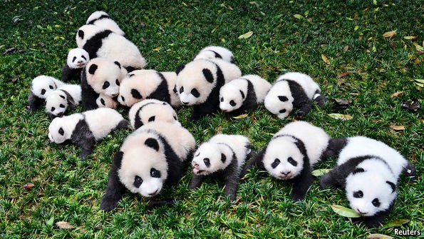
Pandas II
String .str Methods
Grouping

Slide 3
Pandas II
String .str Methods
Grouping

Slide 4
String .str Methods
The Pandas library provides a suite of tools for string/text manipulation.
.str provides access to vectorized string functions for Series and Index.

Slide 5
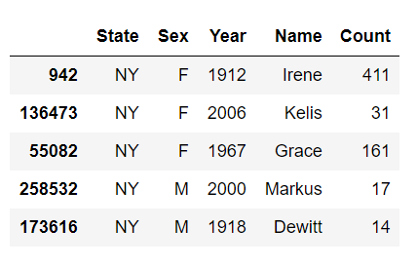
String .str Methods
Let’s review some useful .str methods using the Baby Names dataset.
These are baby names from the state of New York from 1910 to 2018.
Index
State
Series
Sex
Series
Year
Series
Name
Series
Count
Series

Slide 6
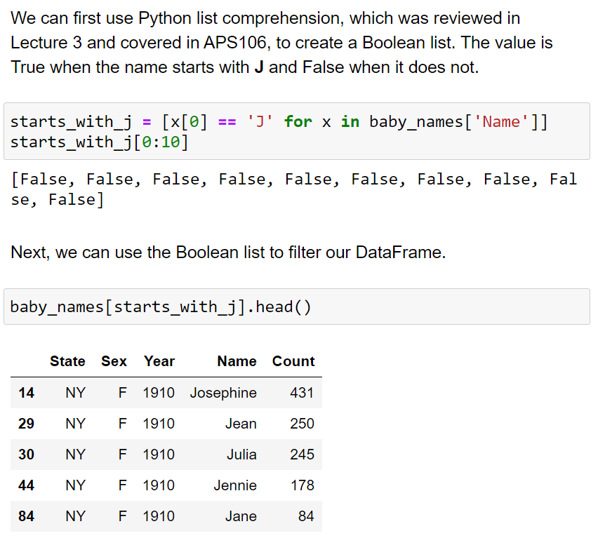
String .str Methods
So, let’s say you want to filter the DataFrame to only include names that start with the letter ‘J’.
John
Janice
Josephine
Jane
We could use the [ ] operator and input a list of Booleans.
my_list = []
for name in by_names[‘Name’]:
if name[0] == ‘J’:
my_list.append(True)
else:
my_list.append(False)

Slide 7
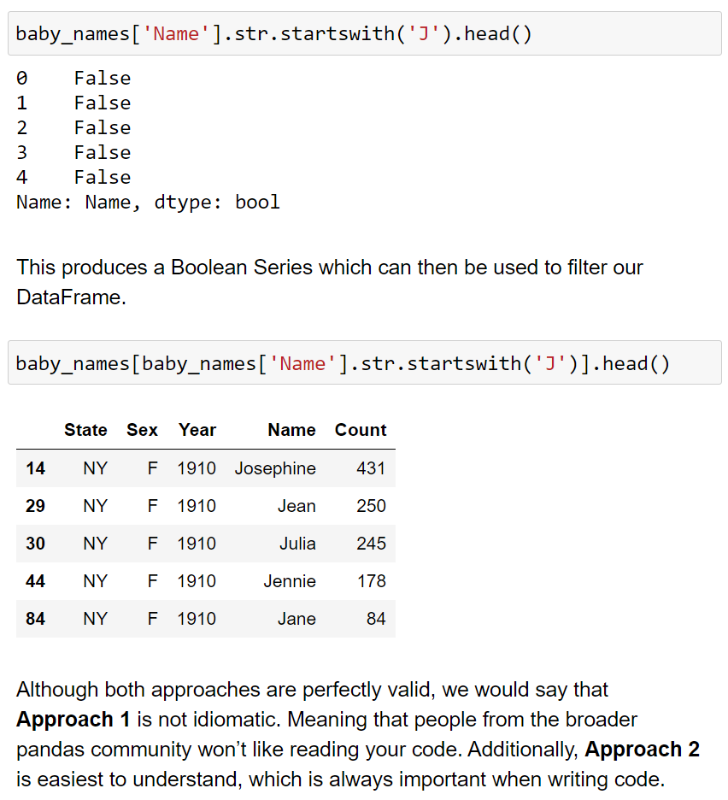
String .str Methods
So, let’s say you want to filter the DataFrame to only include names that start with the letter ‘J’.
John
Janice
Josephine
Jane
We could also use .str.startswith(‘J’)
This method is preferable.
- Idiomatic, easy to understand.

Slide 8
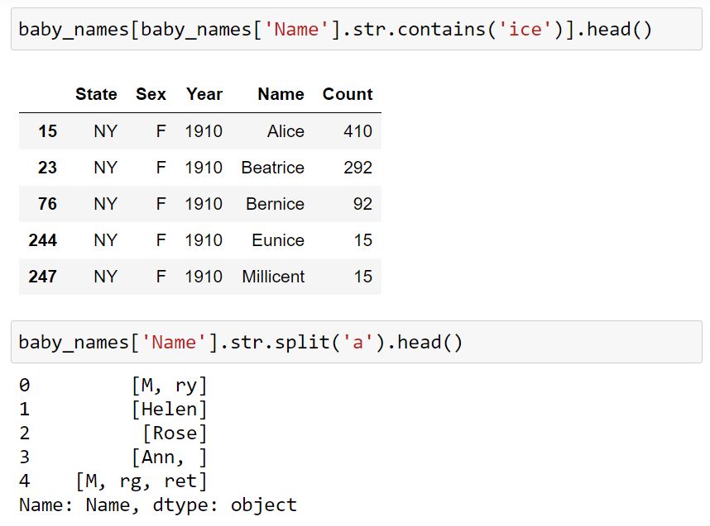
String .str Methods
.str has many other useful methods.
.str.contains()
.str.lower()
.str.upper()
.str.capitalize()
.str.count()
.str.isdigit()
.str.replace()
More here.

Slide 9
Pandas II
String .str Methods
Grouping

Slide 10
Grouping
A .groupby() operation involves some combination of splitting the object, applying a function, and combining the results.
This can be used to group large amounts of data and compute operations on these groups.

Slide 11
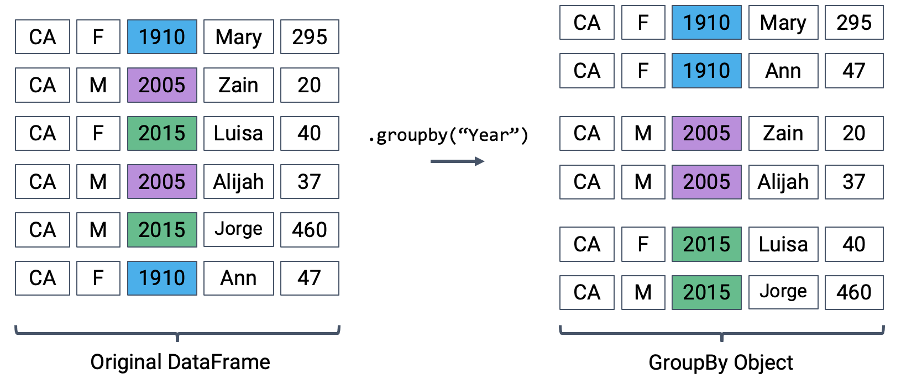
Grouping
Split → Apply → Combine
.groupby()
A groupby operation involves some combination of splitting the object, applying a function, and combining the results.
Calling .groupby() generates DataFrameGroupBy objects → "mini" sub-DataFrames.
Each subframe contains all rows that correspond to a particular year.
Image by Narges Norouzi, Lisa Yan, Josh Hug

Slide 12
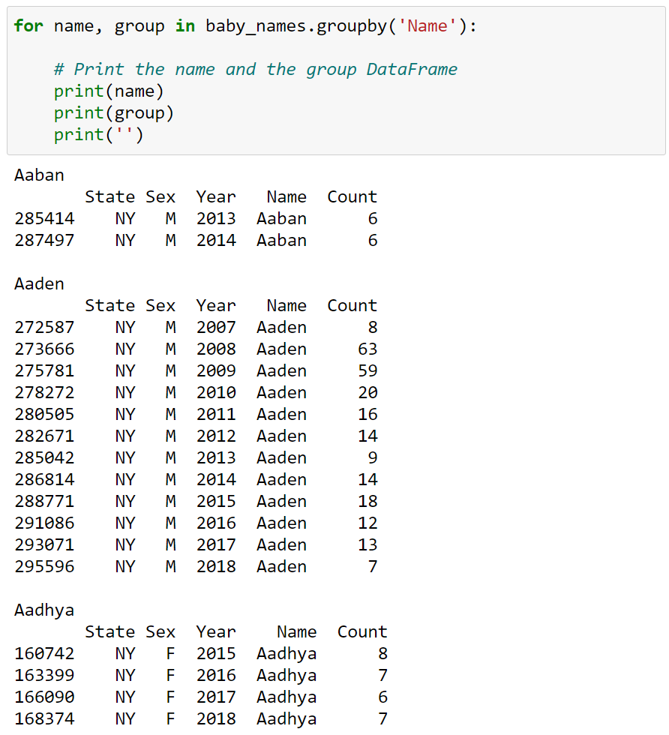
Grouping
DataFrame
.groupby()
Split
A DataFrame is split (grouped) into smaller DataFrames according to a column name or multiple column names.

Slide 13
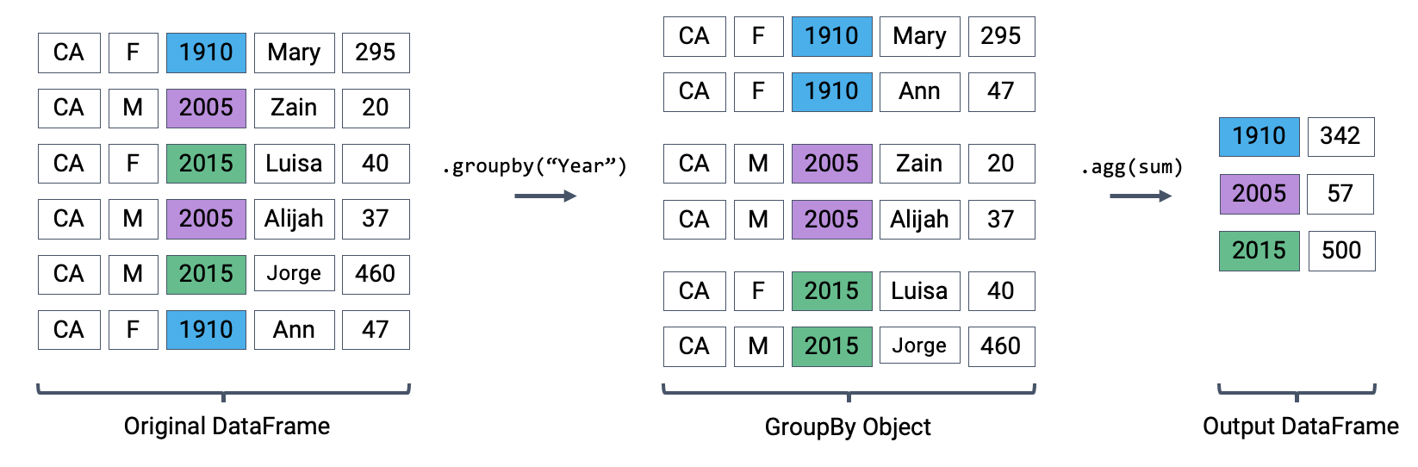
Grouping
Split → Apply → Combine
Index is
monotonic
Index becomes year
0
1
2
3
4
5
Image by Narges Norouzi, Lisa Yan, Josh Hug

Slide 14
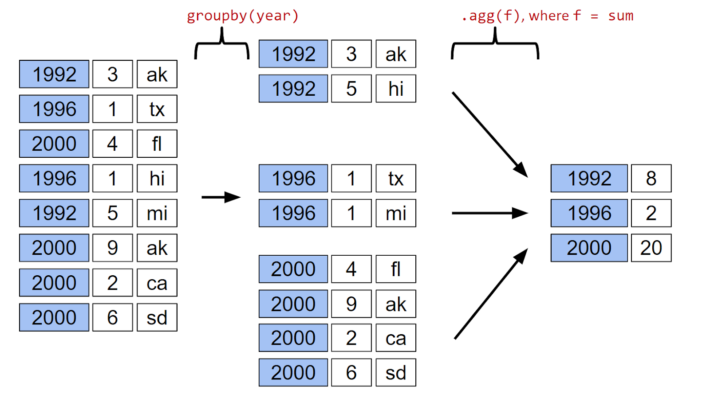
Grouping
Split → Apply → Combine
Image by Josh Hug

Slide 15
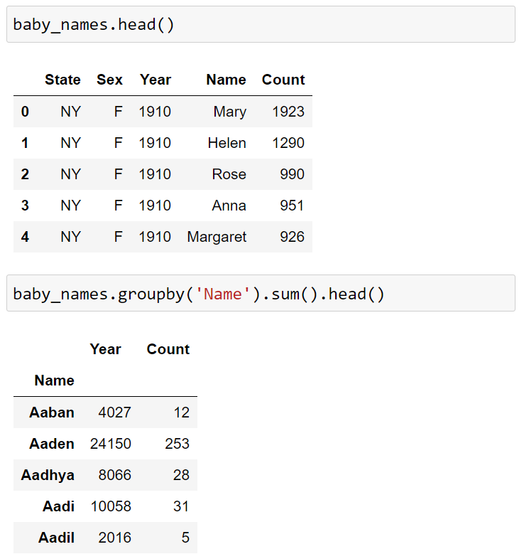
Grouping
.groupby()
Apply
We can apply a number of functions, both built-in and custom, to these smaller grouped DataFrames.
Aggregation
Transformation
Filtering
Applying our own function

Slide 16
Grouping
.groupby()
Combine
Lastly, we combine the output into a new DataFrame where the index is set to the .groupby() key (‘Name’).

Slide 17
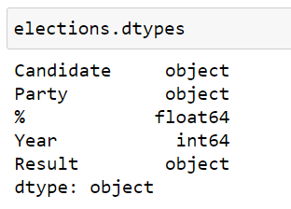
Grouping
.groupby()
You cannot take the sum of a Series of strings.
This can be confusing and lead to problems if you don’t understand what’s happening under the hood.
Where did these columns go?

Slide 18
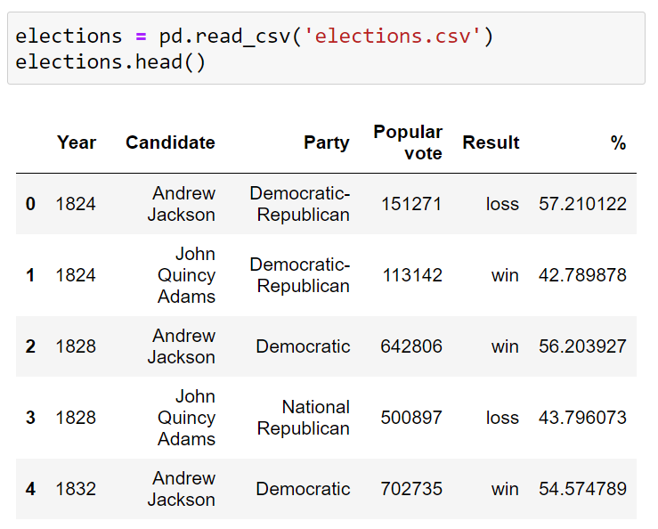
Grouping
.groupby()
Let’s import the elections dataset.

Slide 19
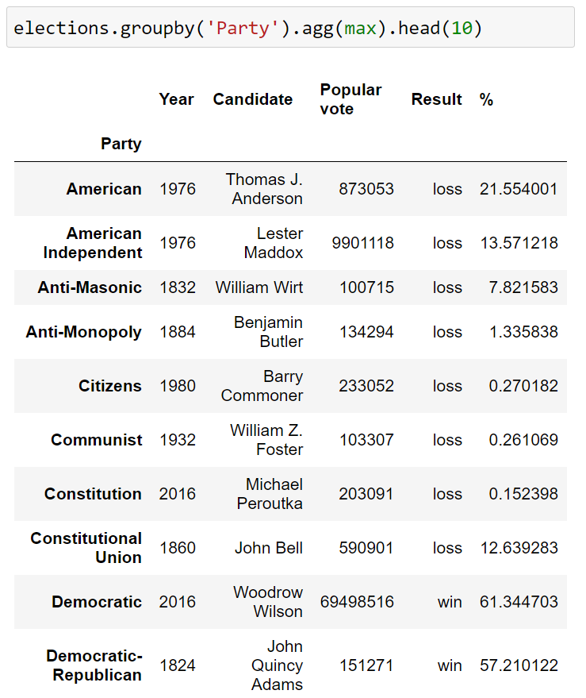
Grouping
.groupby()
Let’s apply max function.
We have to be careful when using aggregation functions.
For example, the results might be misinterpreted to say that Woodrow Wilson ran for election in 2016. Why is this happening?
Every column is calculated independently! Among Democrats:
Last year they ran: 2016
Alphabetically latest candidate name: Woodrow Wilson
Highest number of votes: 69498516
Alphabetically latest Result ['loss', 'win']: win
Highest % of vote: 61.34
Do you see anything misleading?

Slide 20
Grouping
.groupby()
Let’s apply max function.
We have to be careful when using aggregation functions.
For example, the results might be misinterpreted to say that Woodrow Wilson ran for election in 2016. Why is this happening?
Every column is calculated independently! Among Democrats:
Last year they ran: 2016
Alphabetically latest candidate name: Woodrow Wilson
Highest number of votes: 69498516
Alphabetically latest Result ['loss', 'win']: win
Highest % of vote: 61.34

Slide 21
Grouping
.groupby()
Here, we are using the aggregation .agg() method to apply the .max() function.
Note that .agg(max) and .max() result in the same output.
The aggregation .agg() method can apply built-in function (min, max, mean, etc.) and custom functions as well.

Slide 22
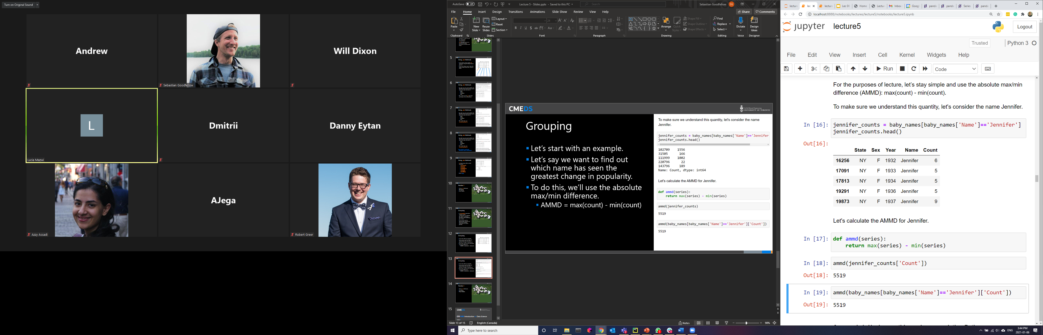
Grouping
Let’s switch back to the baby names dataset and apply a custom function.
Let’s say we want to find out which name has seen the greatest change in popularity.
To do this, we’ll use the absolute max/min difference.
AMMD = max(count) - min(count)

Slide 23
Grouping
Let’s switch back to the baby names dataset and apply a custom function.
Let’s say we want to find out which name has seen the greatest change in popularity.
To do this, we’ll use the absolute max/min difference.
AMMD = max(count) - min(count)

Slide 24
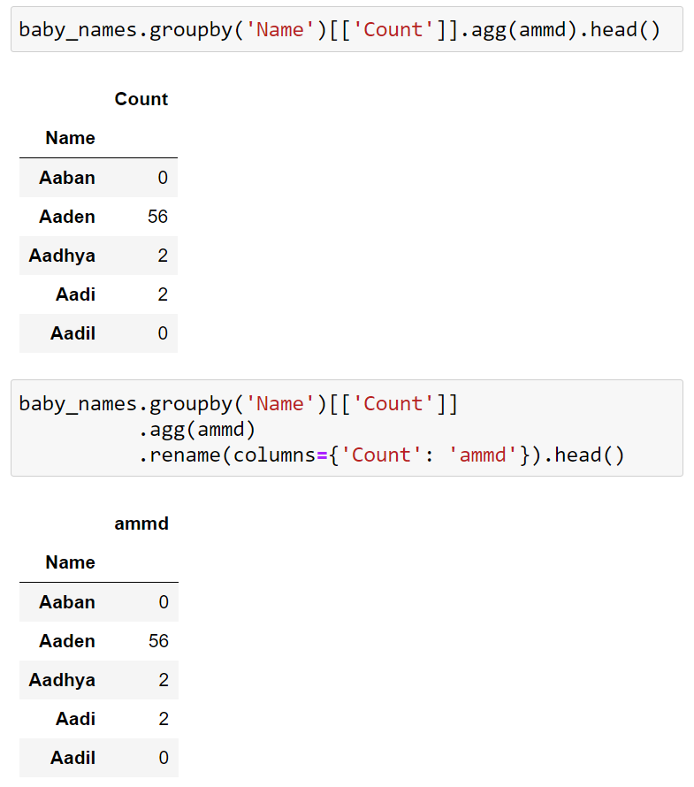
Grouping
So, we will want to do the following:
Group the data by name:
DataFrame for Jennifer
DataFrame for Matt
DataFrame for Karl
etc.
Calculate the ammd for each name.
Create a new DataFrame including names and ammd.
We can do this using .groupby() and .agg().

Slide 25
Grouping
So, we will want to do the following:
Group the data by name:
DataFrame for Jennifer
DataFrame for Matt
DataFrame for Karl
etc.
Calculate the ammd for each name.
Create a new DataFrame including names and ammd.
We can do this using .groupby() and .agg().

Slide 26
Grouping
So, we will want to do the following:
Group the data by name:
DataFrame for Jennifer
DataFrame for Matt
DataFrame for Karl
etc.
Calculate the ammd for each name.
Create a new DataFrame including names and ammd.
We can do this using .groupby() and .agg().

Slide 27
Grouping
So, we will want to do the following:
Group the data by name:
DataFrame for Jennifer
DataFrame for Matt
DataFrame for Karl
etc.
Calculate the ammd for each name.
Create a new DataFrame including names and ammd.
We can do this using .groupby() and .agg().

Slide 28
Grouping
So, we will want to do the following:
Group the data by name:
DataFrame for Jennifer
DataFrame for Matt
DataFrame for Karl
etc.
Calculate the ammd for each name.
Create a new DataFrame including names and ammd.
We can do this using .groupby() and .agg().

Slide 29
Grouping
So, we will want to do the following:
Group the data by name:
DataFrame for Jennifer
DataFrame for Matt
DataFrame for Karl
etc.
Calculate the ammd for each name.
Create a new DataFrame including names and ammd.
We can do this using .groupby() and .agg().

Slide 30
Grouping
So, we will want to do the following:
Group the data by name:
DataFrame for Jennifer
DataFrame for Matt
DataFrame for Karl
etc.
Calculate the ammd for each name.
Create a new DataFrame including names and ammd.
We can do this using .groupby() and .agg().

Slide 31
Grouping
.groupby()
Apply
We can apply a number of functions, both built-in and custom, to these smaller grouped DataFrames.
Aggregation
Transformation
Filtering
Applying our own function

Slide 32
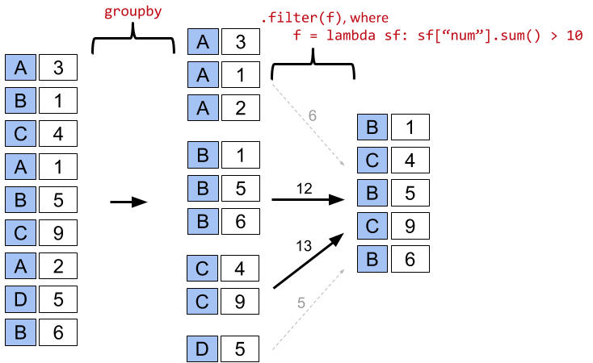
Grouping
Only include data from months with more than 10 million in revenue.
.filter()
Filter gives a copy of the original DataFrame where row r is included if its group obeys the given condition.
Note: Filtering is done per GROUP, not per ROW.
Image by Josh Hug

Slide 33
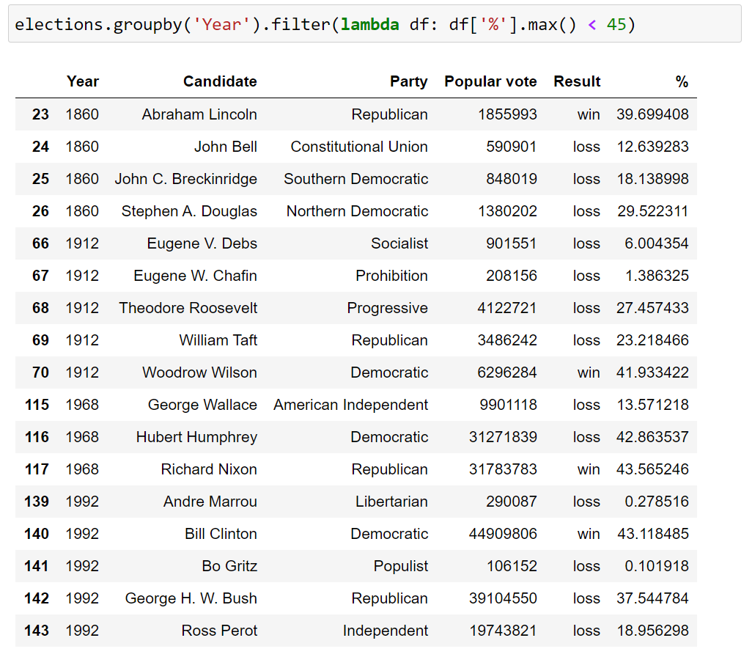
Grouping
.filter()
Filter gives a copy of the original DataFrame where row r is included if its group obeys the given condition.
Note: Filtering is done per GROUP, not per ROW.

Slide 34
Practice!
Launch the Lecture 2.2 notebook from Quercus and review the material from this lecture in more detail.
Link

Slide 35
CME538 Introduction to Data Science
Week 2 | Lecture 2 (2.2)
Pandas II.

